Slide 1
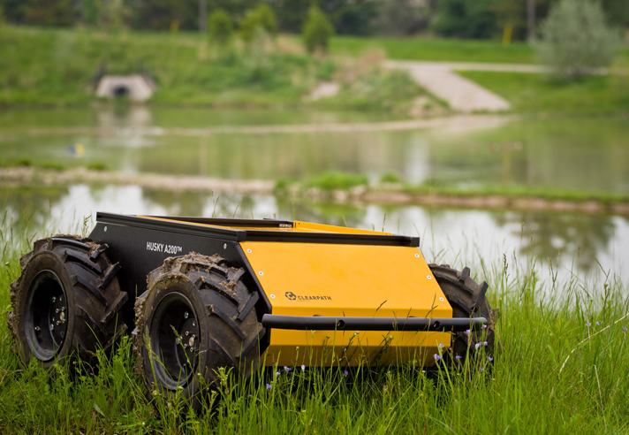
CMPEN 417 Final Presentation
By:
Bryan Dickens bid5098@psu.edu
Gabe Harms gph5040@psu.edu
Neal Malkani nxm5132@psu.edu
Andrew Quintero adq5006@psu.edu
Luke Uliana lju5011@psu.edu
Joe Wolfe jew5246@psu.edu
Under: Professor John Sustersic jps263@psu.edu
FPGA controller design for the Husky Robot

Slide 2
Design Plan
Implement serial Read/Write
Build a comprehensive System Verilog instruction encoder and decoder for the Clearpath API
Develop a state machine following the set progression of instructions.
IR obstacle direction with Arduino

Slide 3
Fixed Course Design
We decided early on to have our robot traverse the fixed course of:
Initial Configuration
Straight at a desired speed then wait until travelled 10 meters.
Left turn with a desired speed and radius for 90 degrees.
Straight again for 10 meters.
Right turn with a desired speed and radius for 90 degrees.
Straight again for 10 meters to the finish line.

Slide 4
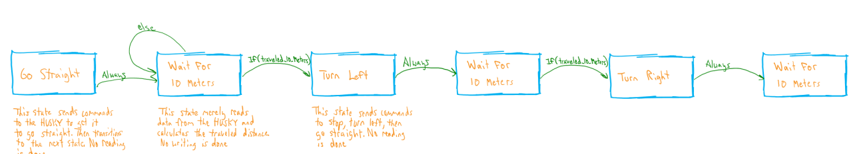
State Machine
We chose to design our module as a state machine rather then use a PID. For our project, the state machine was a better option since all of our directions are discrete steps (i.e. move forward, turn left, etc.).

Slide 5
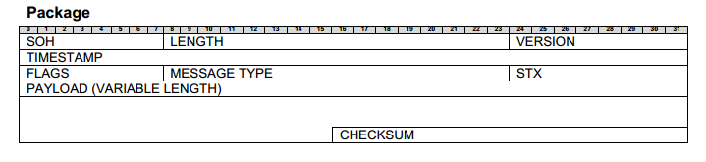
Simulation Verification
Here is a generic data package for the Husky Robot.

Slide 6
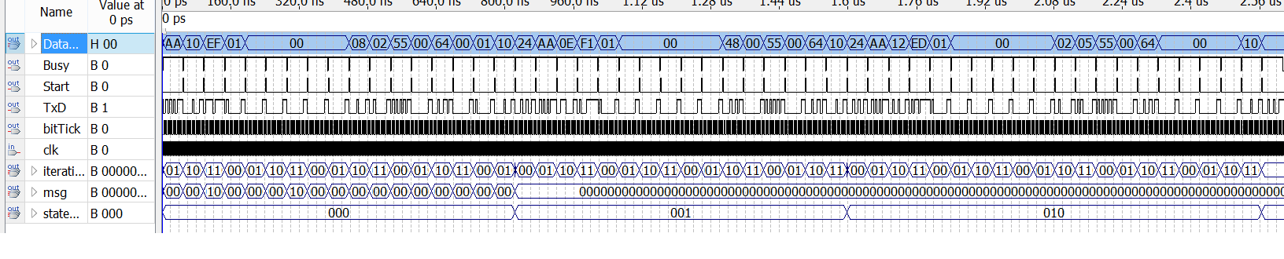
Full Simulation

Slide 7
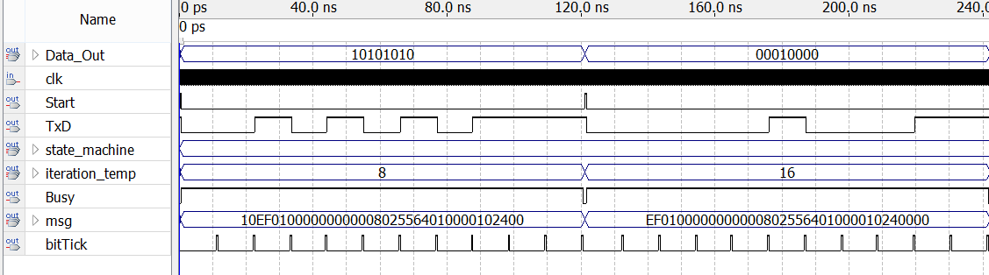
Byte Zoomed Simulation
The simulation above shows a simulated message for our control system.
- Binary 10101010 out to the transmitter TxD.
- First and last bitTick’s are the start and end bits
- TxD shows data being sent correctly one bit at a time in the middle 8 bits.
- Following binary 00010000
Has already read the starting SOH bytes of 0xAA
0xEF01 dictate message length
Version number 0x01
Timestamp and flags are 0x00000000 and 0x00.
Message type is 0x0802 followed by the stx 0x55
Payload of data here is 0x64010000 = desired wheel samples per resolution is 0x64 and scale of distance data received is 0x01
Final part of message is 0x1024 which is our crc

